Slide 1

Design and Implementation of a Secure Network-Based File Transfer and Sharing System
CSA0702: COMPUTER NETWORKS
COURSE FACULTY :
Dr.R.Senthamil Selvan B.E,M.Tech(CS),M.Tech(CSE), Phd,MISTE,FIETE
Associate Professor
Department of ECE
SIMATS Engineering Saveetha University,Thandalam,Chennai
PRESENTED BY:-
VARSHAN G(19241054)
V.SREE RUTHIN REDDY(192324112)
V.SHEERSHIKA(192472056)
VISHAL M(192565077)
Y.MANOJ KUMAR(192311141)

Slide 2


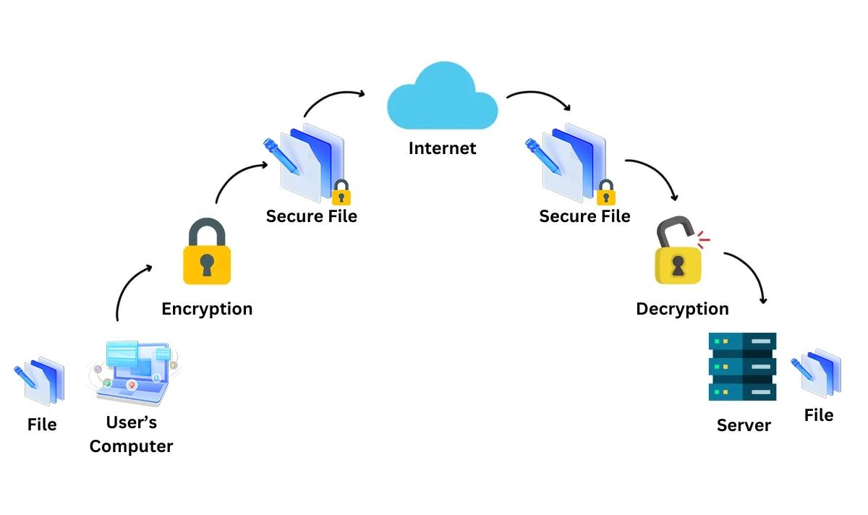
INTRODUCTION
This project develops a secure client-server file transfer and sharing system that allows users to upload, download, store, and share files safely over a network.
The system uses AES encryption to protect files, BCrypt password hashing to secure user passwords, and role-based access control (RBAC) to allow only authorized users to access files.
It is built using Java, TCP/IP protocol, Socket Programming, JDBC, and MySQL to provide secure communication and reliable file management between the client and server.
The system also keeps activity logs of user actions such as login, file upload, download, and sharing, helping improve security, monitoring, and overall system reliability.
Fig.1 Introduction of Secure Network Based File System

Slide 3
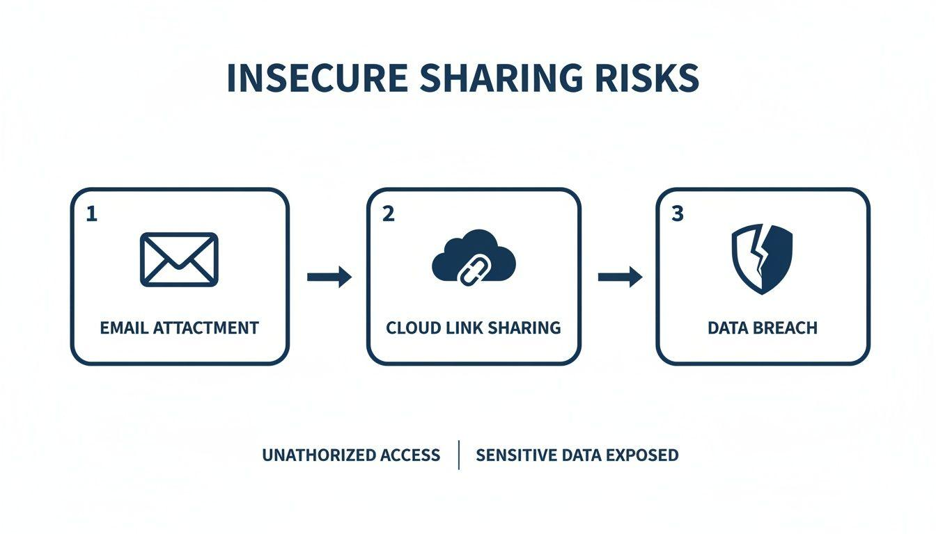
PROBLEM STATEMENT
Many existing file transfer systems have security weaknesses that can put sensitive data at risk.
Files transferred over a network may be accessed or intercepted by unauthorized users.
Many systems do not provide strong authentication or proper user access control.
Files are often stored without encryption, increasing the risk of data theft or modification.
Lack of activity logging makes it difficult to monitor user actions and detect security issues.

Slide 4
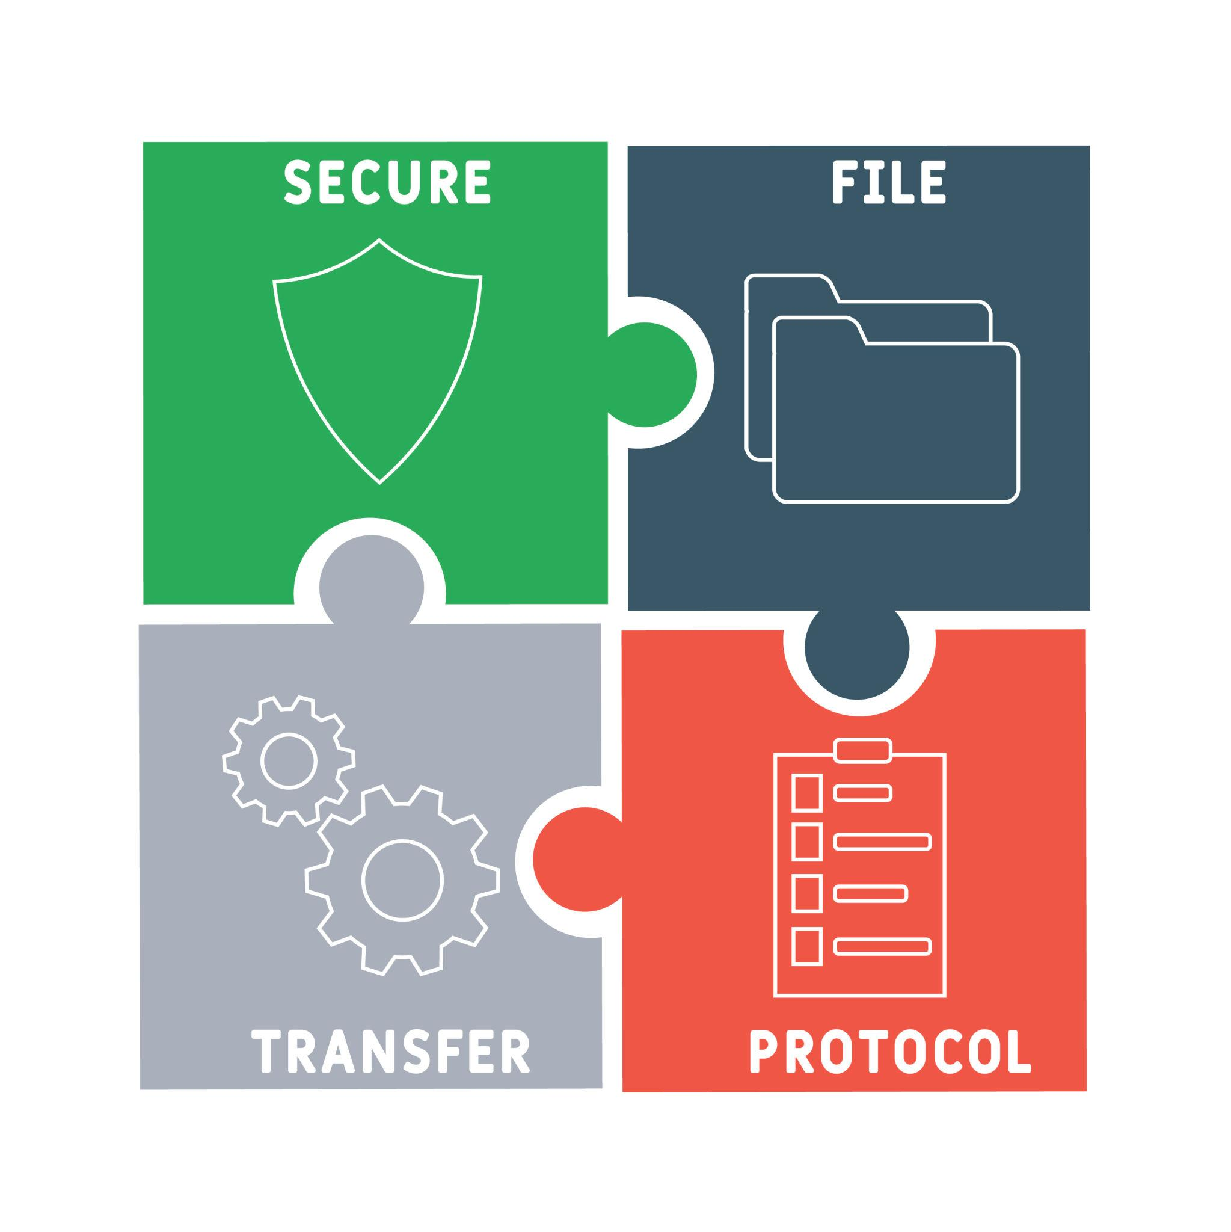
OBJECTIVES
The main objectives of this project are:
Develop a secure client-server file transfer and sharing system.
Protect user accounts using secure authentication and password hashing.
Encrypt files before transmission to ensure data confidentiality.
Store files securely and manage file information in a database.
Allow secure file sharing with role-based access permissions.
Monitor user activities by maintaining audit logs and system records.
Fig.2 Objectives of the Project

Slide 5
LITERATURE SURVEY
Existing System | Drawback | Our Proposed Solution
Basic FTP File Transfer System | Files are transferred without encryption, making data vulnerable to interception. | Uses AES Encryption to protect files during transmission.
Traditional File Sharing System | Weak user authentication and no proper access control. | Uses BCrypt Password Hashing and Role-Based Access Control (RBAC) for secure authentication and authorization.
Conventional Client-Server File Transfer System | No activity logging or monitoring of user actions. | Maintains Audit Logs to record logins, file uploads, downloads, and sharing activities for better security.
Table.1 Literature Review of Existing Systems

Slide 6
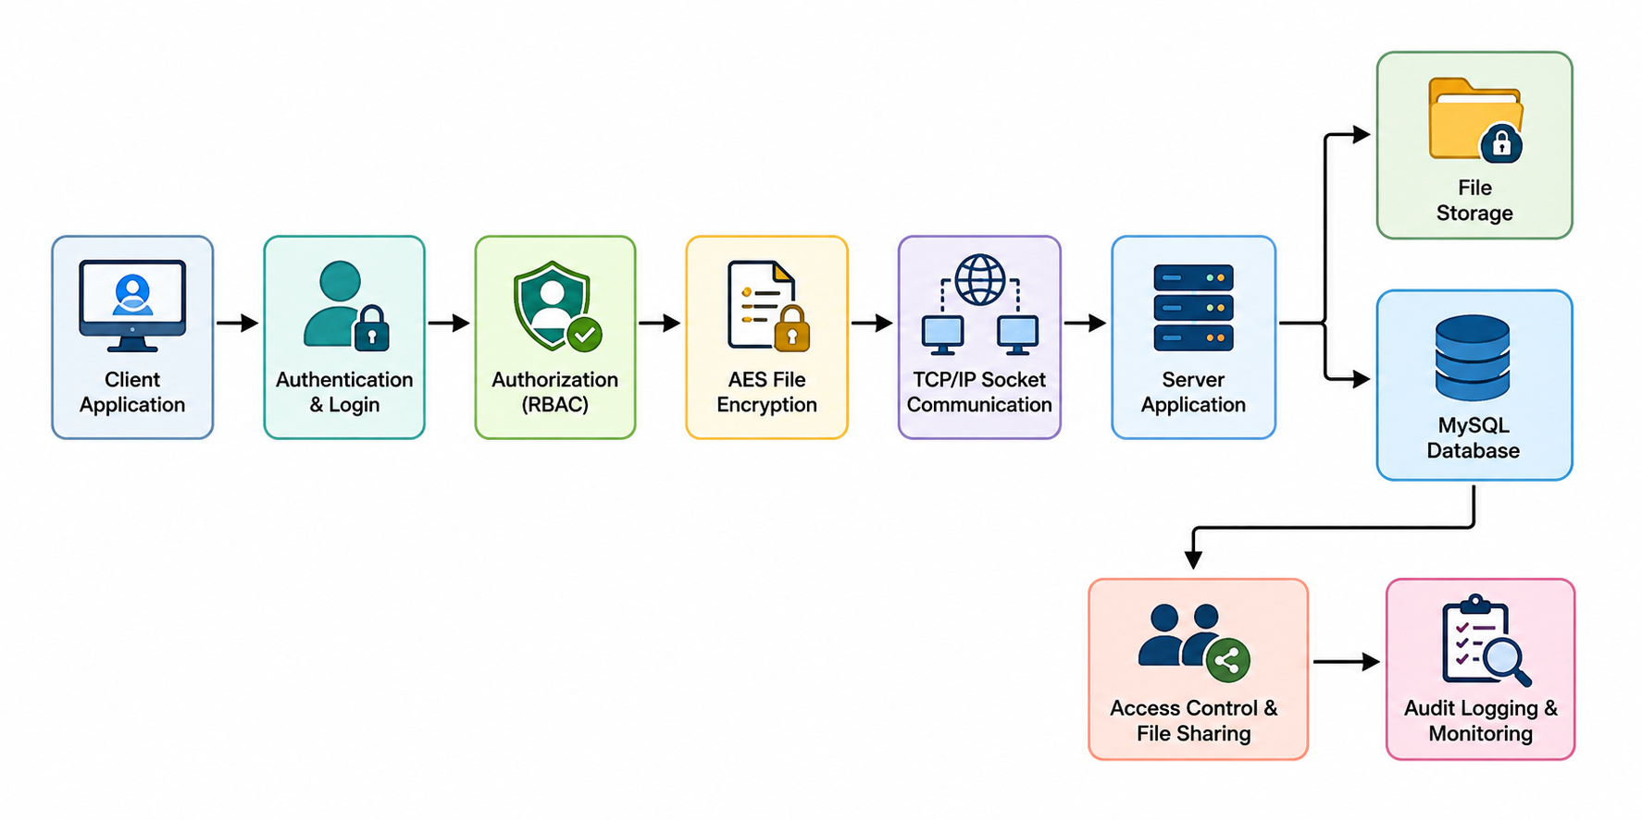
SYSTEM ARCHITECTURE
Fig.3 Project Workflow

Slide 7
PROJECT MODULES
The proposed system is divided into five major modules, each responsible for a specific security and file management function.
Authentication & Authorization Module
Secure File Storage Module
Encrypted File Transmission Module
Access Control & File Sharing Module
Audit Logging & Network Monitoring Module

Slide 8

MODULE-1: AUTHENTICATION & AUTHORIZATION MODULE
Introduction
Allows users to register and log in securely,verifies user identity before granting access.
Controls access based on user roles and permissions,Protects user accounts from unauthorized access.
Technologies Used
Java , BCrypt Password Hashing , JDBC, MySQL Database, Role-Based Access Control (RBAC) , User Session Management
Input Parameters
Username , Password , User Role
Output Parameters
Secure User Authentication
Authorized User Access
Active User Session
Protected User Credentials
Fig.4 Authentication and Authorization

Slide 9
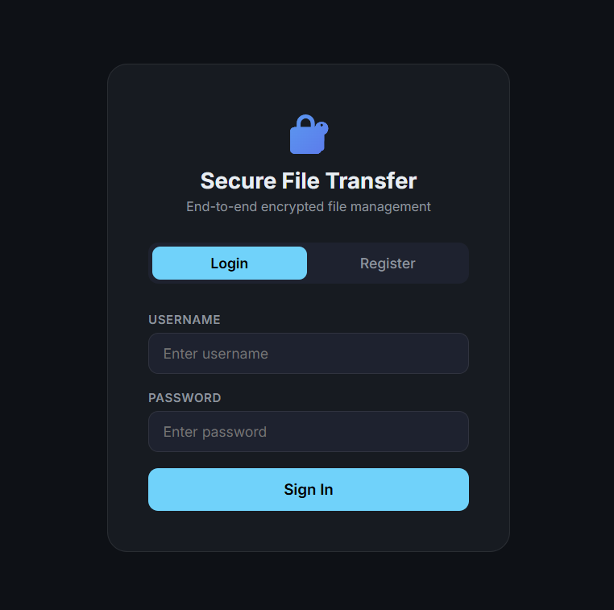
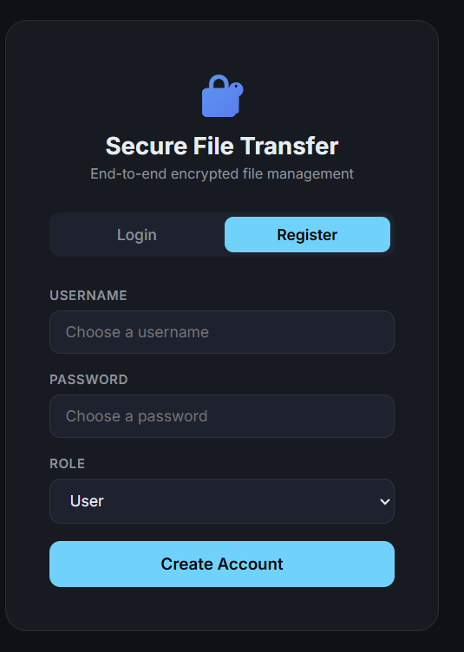
Module 1 Output
Fig.5 Login Page
Fig.6 Register Page

Slide 10
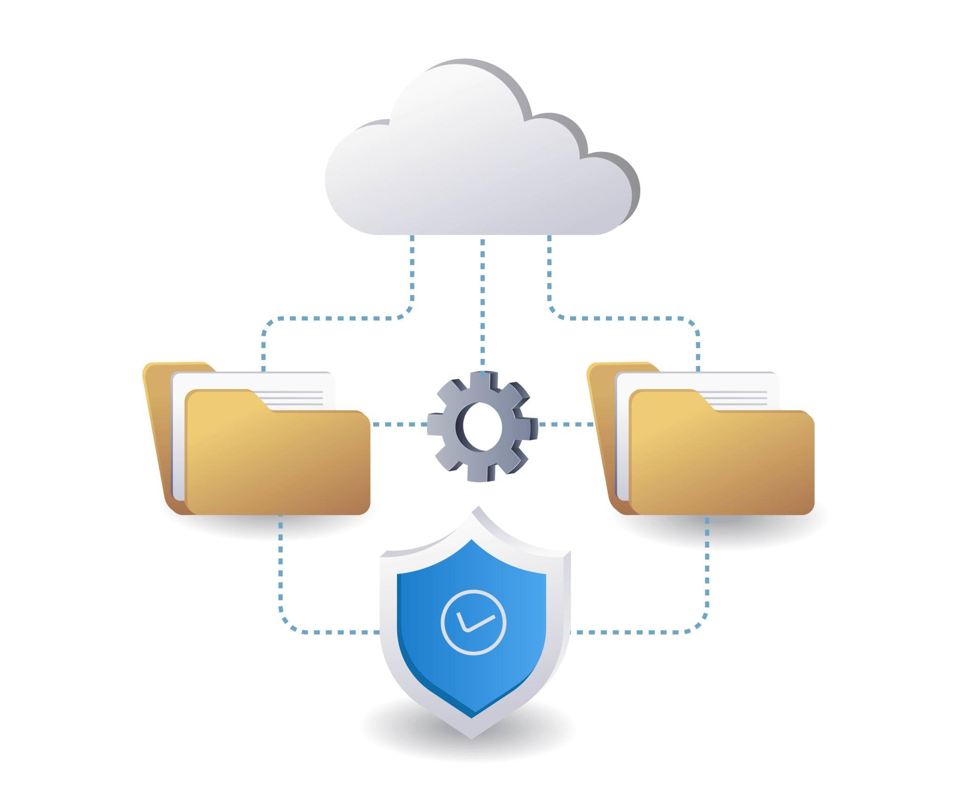
MODULE-2: SECURE FILE STORAGE MODULE
Introduction
Stores uploaded files securely on the server , Organizes files for easy management and retrieval.
Maintains file information such as name, type, and size , Prevents unauthorized access to stored files.
Technologies Used
Java File I/O , MySQL Database , JDBC Connectivity , Server File Storage
Input Parameters
File Name , File Type , File Size , Storage Location
Output
Secure File Storage , Organized File Management
Stored File Metadata
Reliable File Retrieval
Fig.7 Secure File Storage

Slide 11
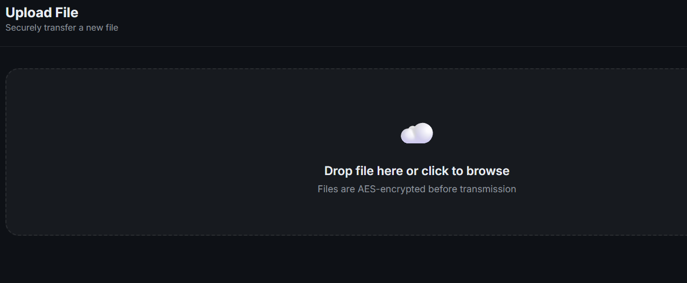
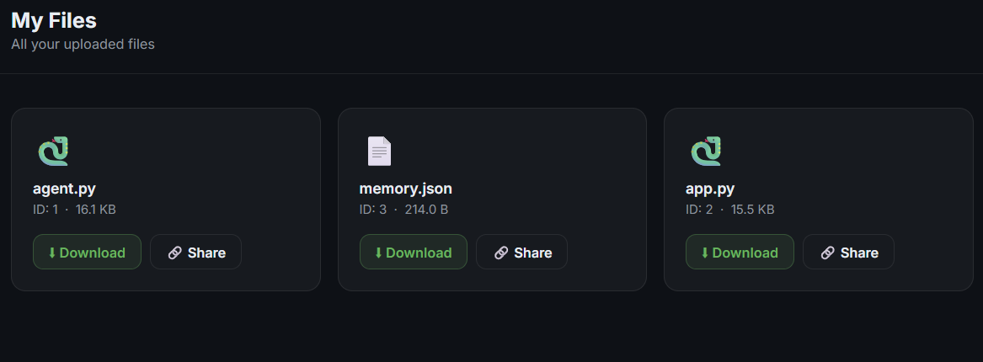
Module 2 Output
Fig. 8 Upload file page
Fig. 9 Uploaded Files

Slide 12
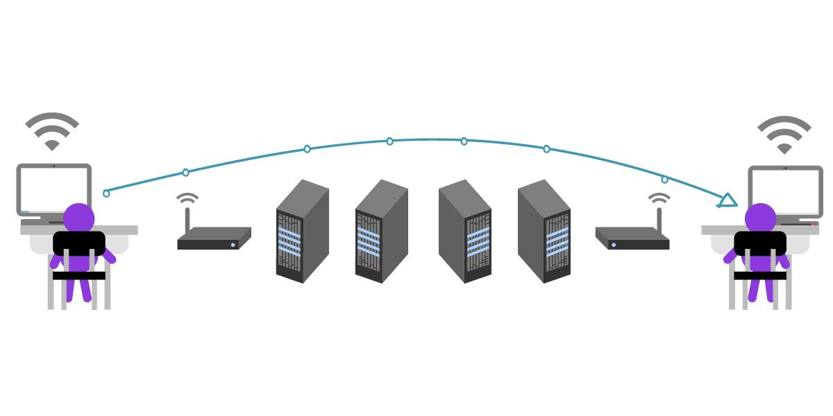
MODULE-3: ENCRYPTED FILE TRANSMISSION MODULE
Introduction
Encrypts files before they are sent over the network , Transfers files securely using the TCP/IP protocol.
Decrypts files after successful transmission , Protects data from unauthorized access during transfer.
Technologies Used
AES Encryption , Java Socket Programming , TCP/IP Protocol , Java Networking
Input Parameters
File , Encryption Key , Network Connection
Output
Encrypted File Transfer , Secure Network Communication
Successful File Delivery
Data Confidentiality
Fig.10 File Transmission

Slide 13
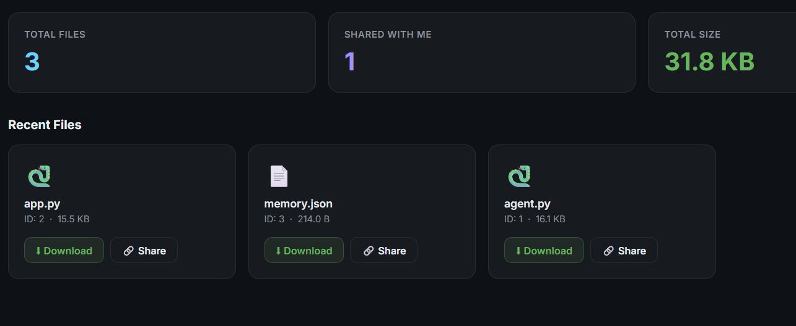
Module 3 Output
Fig. 11 Transmission Files Overview

Slide 14
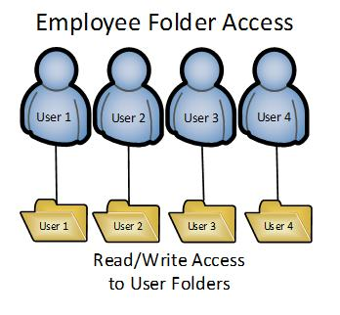
MODULE-4: ACCESS CONTROL & FILE SHARING MODULE
Introduction
Allows users to share files securely with other users , Assigns permissions for viewing, downloading, and modifying files.
Ensures only authorized users can access shared files , Prevents unauthorized file access and modification.
Technologies Used
Access Control Lists (ACL) , Role-Based Access Control (RBAC)
JDBC Connectivity , MySQL Database
Input Parameters
User ID , File ID , Access Permission
Output
Secure File Sharing
Permission-Based Access
Authorized File Downloads
Controlled File Modification
Fig.12 File Sharing Access Control

Slide 15
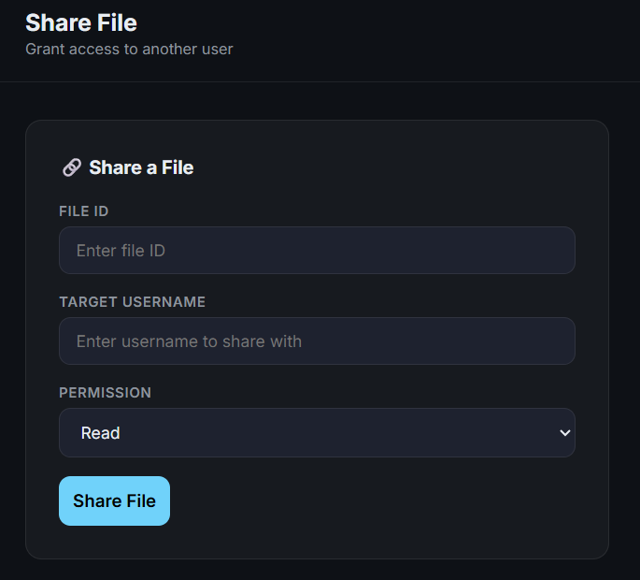
Module 4 Output
Fig.13 File Sharing Page

Slide 16

MODULE-5: AUDIT LOGGING & NETWORK MONITORING MODULE
Introduction
Records all user activities in the system , Monitors file uploads, downloads, and sharing operations.
Tracks login and logout activities for security , Helps identify suspicious activities and improve system monitoring.
Technologies Used
Java Logging Framework , MySQL Database , Timestamp Management , Network Monitoring
Input Parameters
User Activity , Timestamp , File Operation , Network Status
Output
Activity Logs
Security Reports
User Activity Monitoring
System Audit Records
Fig.14 Audit Log Monitoring

Slide 17
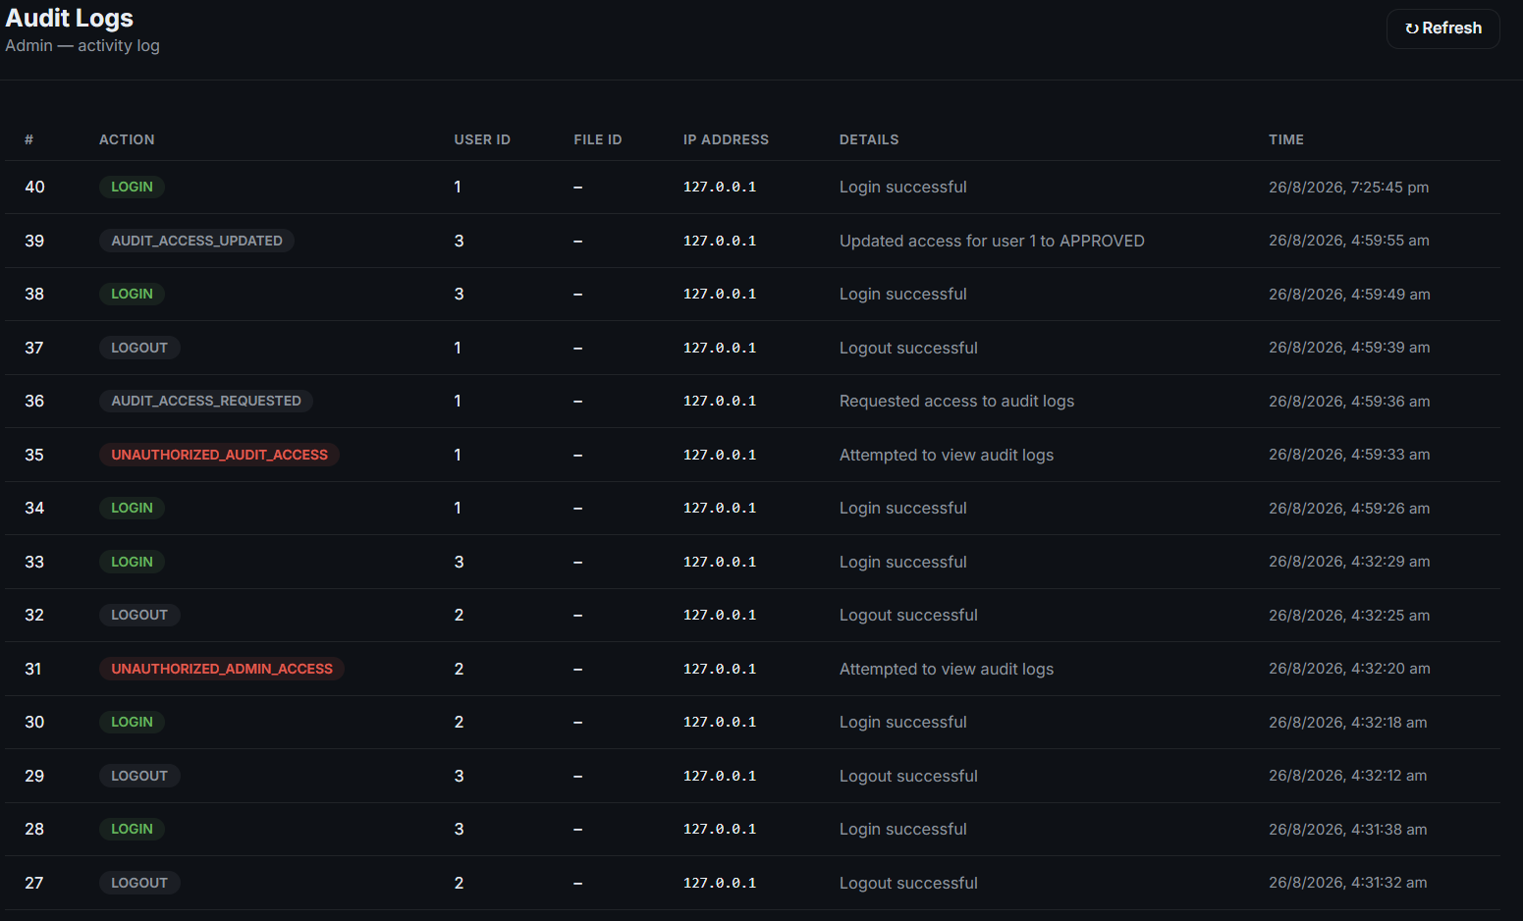
Module 5 Output
Fig.15 Audit Log Monitoring

Slide 18
CONCLUSION
CONCLUSION
Developed a secure client-server file transfer and sharing system using Java.
Protected user accounts with BCrypt authentication and files with AES encryption.
Enabled secure file storage and permission-based file sharing using RBAC and ACL.
Ensured reliable communication through TCP/IP socket programming.
Improved system security by maintaining audit logs and monitoring user activities.
Future Enhancements
Cloud storage integration
Multi-factor authentication (MFA)
Mobile application support
Real-time security alerts

Slide 19

APPLICATIONS & BENEFITS
Applications
Organizations for secure document sharing
Hospitals for sharing patient records securely
Banks for transferring confidential financial documents
Educational institutions for sharing study materials and reports
Cloud and enterprise file management systems
Fig.16 Applications and Benefits
Benefits
Secure file transfer using AES encryption
Strong user authentication with BCrypt
Controlled access using RBAC and ACL
Safe file storage and easy file management
Audit logging for monitoring user activities
Reliable communication through TCP/IP

Slide 20
References
Rath, S., Priyadarshini, B., Patel, D. K., Sahu, P. K., Jagadev, N., Panda, M., Patra, N., & Sahoo, S. (2024). AES-RSA: An Innovative Hybrid Security Framework for File Authentication, Integrity, and Data Secrecy Model. International Journal of Intelligent Systems and Applications in Engineering.
Ganeeb, K. K., Jayaram, V., Krishnappa, M. S., Gupta, P., Nagpal, A., Banarse, A. R., & Aarella, S. G. (2024). Advanced Encryption Techniques for Securing Data Transfer in Cloud Computing: A Comparative Analysis of Classical and Quantum-Resistant Methods. International Journal of Computer Applications.
Liauren, R. M., Zaman, B., & Bahri, S. (2025). Implementation of AES and BCrypt Algorithms for Securing User Data on the Jahitku Website. KHARISMA Tech, 20(1), 57–71.
Sai Kumar, J., & Bhaskara Murthy, V. (2025). Secure File Transfer Using AES & RSA Algorithms. International Journal of Engineering Research and Science & Technology, 21(2), 1282–1289.
Widianti, F., Khair, F., Widodo, A. M., & Cahyadi, E. F. (2026). Socket-based File Transfer System using AES-256 and OTP Authentication. JURNAL INFOTEL, 18(1), 114–127.

Slide 21
THANK YOU

